Slide 1
Lesson: Case File XY
Inheritance Dispute Twine Game Activity
Notes:
Credit: Kevin Tran (June 2022)

Slide 2
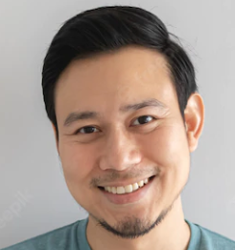
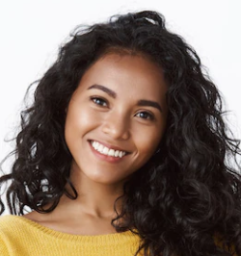
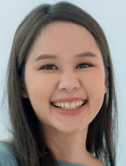
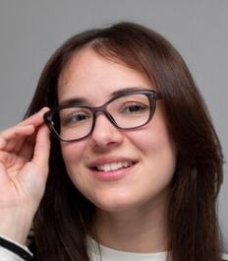
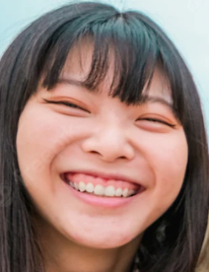
Which of the four people below do you think is a biological child of this person?
Notes:
https://www.freepik.com/premium-photo/young-friends-from-diverse-cultures-races-taking-photo-making-happy-faces-youth-millennial-generation-friendship-concept-with-students-people-having-fun-together-focus-close-up-girls_7509987.htm#query=people%20faces&position=21&from_view=search
https://www.freepik.com/premium-photo/happy-man-with-clear-innocent-smile-face_5739977.htm#query=people%20faces&position=43&from_view=search
https://www.freepik.com/free-photo/medium-shot-smiley-people-posing-together_27509142.htm#query=people%20collage&position=46&from_view=keyword
<a href="https://www.freepik.com/photos/woman-tablet">Woman tablet photo created by Lifestylememory - www.freepik.com</a>
<a href="https://www.freepik.com/photos/african-lady">African lady photo created by cookie_studio - www.freepik.com</a>

Slide 3
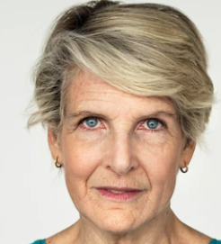
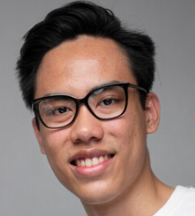
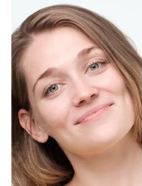
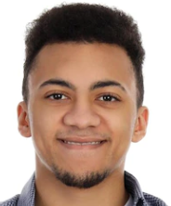

Which of the four people below do you think is a biological child of this person?
Notes:
<a href="https://www.freepik.com/photos/senior-woman">Senior woman photo created by rawpixel.com - www.freepik.com</a>
https://www.freepik.com/premium-photo/collage-young-senior-people-smiling-confident-camera-studio-shot_23761302.htm#query=old%20people%20collage&position=30&from_view=search
https://www.freepik.com/free-photo/medium-shot-smiley-people-posing-together_27509142.htm#query=people%20collage&position=46&from_view=keyword
<a href="https://www.freepik.com/photos/happy-asian">Happy asian photo created by Lifestylememory - www.freepik.com</a>
<a href="https://www.freepik.com/photos/african-man">African man photo created by atlascompany - www.freepik.com</a>

Slide 4
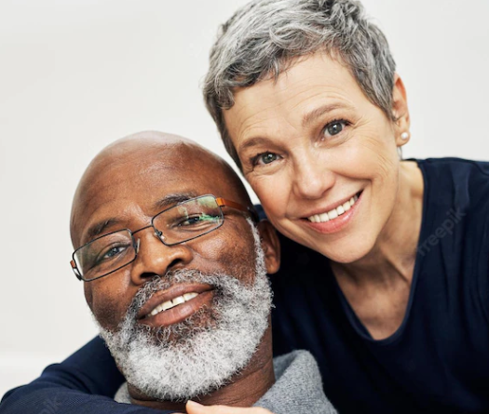

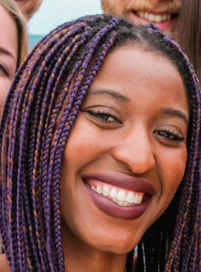
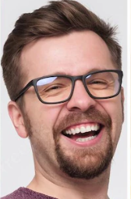
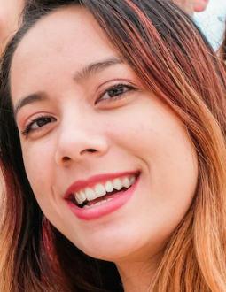
Which of the six people below do you think is a biological child of this couple?
Notes:
<a href="https://www.freepik.com/photos/woman">Woman photo created by diana.grytsku - www.freepik.com</a>
https://www.freepik.com/premium-photo/all-that-matters-is-that-were-together-cropped-portrait-affectionate-senior-couple-relaxing-sofa-home_27151281.htm#page=6&query=old%20people&position=26&from_view=search
https://www.freepik.com/premium-photo/collage-young-senior-people-wearing-reading-glasses-smiling_23761296.htm#query=old%20people%20collage&position=29&from_view=search
https://www.freepik.com/premium-photo/young-friends-from-diverse-cultures-races-taking-photo-making-happy-faces-youth-millennial-generation-friendship-concept-with-students-people-having-fun-together-focus-close-up-girls_7509987.htm#query=people%20collage&position=20&from_view=keyword
<a href="https://www.freepik.com/photos/african-man">African man photo created by atlascompany - www.freepik.com</a>

Slide 5
Phenotype – A physical, measurable trait. Genotype – The genetic information that _ decides the phenotype Allele
Notes:
The answers to Phenotype and Genotype are obscured by a white box. Drag or delete the box to show the answer.

Slide 6
Q1. What is an allele, where does it come from, and how does it result in a phenotype?
Q2. Why are some characteristics much less common than others? (e.g., red hair)
Q3. Why may some people look like siblings even if they do not share common parents?

Slide 7
Twine Game Activity
You will be making an investigation game with the goal of identifying the biological child.
<TWINE TEMPLATE URL>

Slide 8
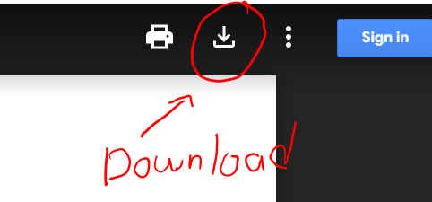
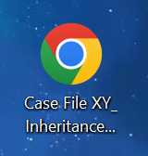

<TWINE TEMPLATE URL>
Should look something like this. Icon will depend on your browser.
Import downloaded HTML file using
Library > Import
Download file and place on your Desktop.

Slide 9
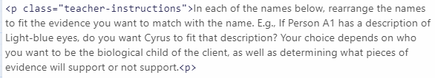
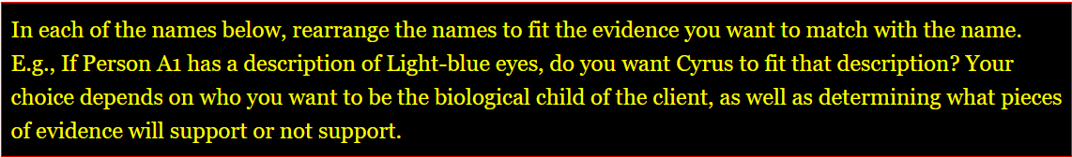
Getting Started
Teacher instructions will look like this:
Instructions will guide you on what needs to be done. We will hide it for the finished game by changing the story’s Stylesheet (display: none;).
Test story from the ‘D and R passage’ to obtain valuable information on Dominant and Recessive alleles. You need this information to add to the story.

Slide 10

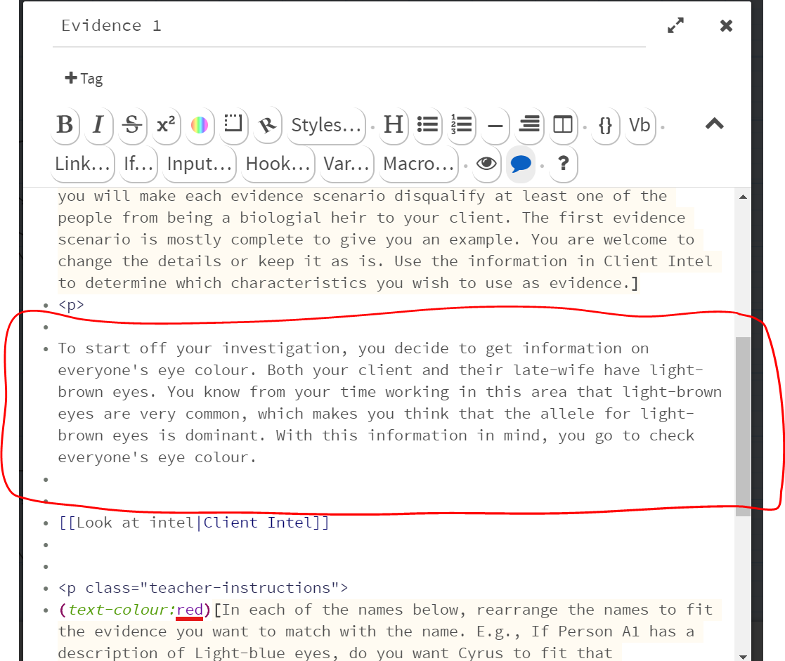
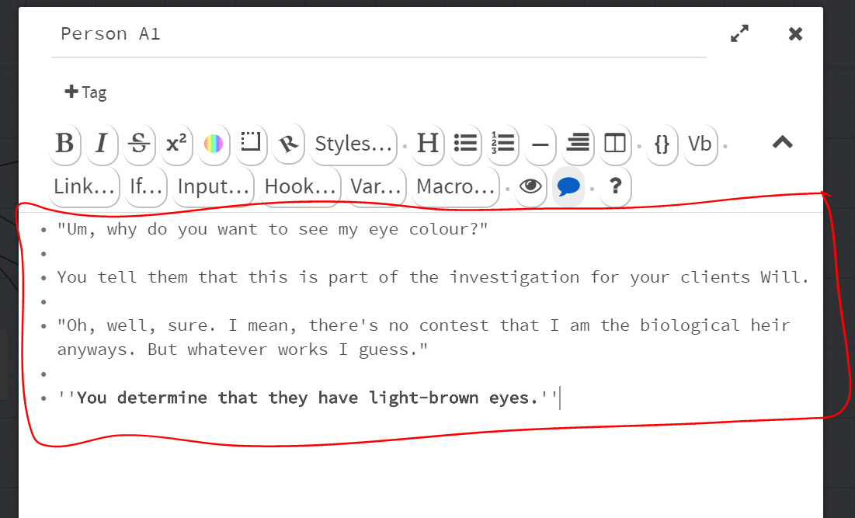
Click the Build > Play button to test your project:
While it may look like a lot of text, remember that you are only writing about this much minimum per evidence:
And you are free to decide how much the character responds. Browse the example of Evidence 1 and character responses to get a feel of how to create the other scenarios.
Note: You are also free to change Evidence 1.

Slide 11
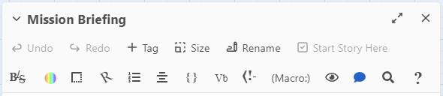
Refer to the paper document provided to make aesthetic changes if you so choose.
The toolbar is great for simple formatting.

Slide 12
To add more evidence passages:
1. Add a new passage, for example: Evidence 5
2. Change the last line that takes you to Investigation Wrap-up:
[[Conclude Investigation|Investigation Wrap-up]]
To link to the next evidence passage, like for Evidence 5:
[[Next Evidence|Evidence 5]]

Slide 13
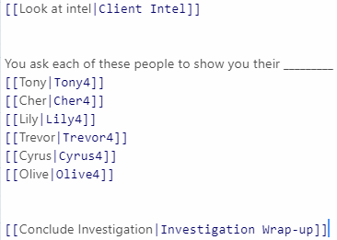
To add more evidence passages (cont.):
3. Copy and paste this section for Evidence 4 into Evidence 5:
4. Change the numbers of each person to a 5. e.g., Tony4 needs to be changed to Tony5, etc.
5. Add passages for each of the children, i.e., Tony5, Cher5, etc.

Slide 14
Q1. What is an allele, where does it come from, and how does it result in a phenotype?
Q2. Why are some characteristics much less common than others? (e.g., red hair)
Q3. Why may some people look like siblings even if they do not share common parents?

Slide 15
What if both alleles have equal power (in other words, there is no dominant)? What happens if a child has a black hair allele and a blond hair allele, and neither is dominant? What will that look like?

Slide 16
For Next Class:
Consider question 4 and think of some examples of what this may look like in: Humans, animals, and plants.
You have 15 minutes of class time next class to finish your games.
You may work on them at home, but it is not mandatory.
Next class we are sharing and peer-reviewing our games with each other in small groups.

